Slide 1


Ballpark Bookie
CMSI 401 Fall 2019
Thomas Ochsner, Kea Braekman, Brett Derham, & Riley Persily

Slide 2
Motivation
Challenges
Results
Sports, and specifically, baseball is something that interests us all. So being able to combine that with our knowledge from 3+ years at this school made for a great project.
Learning data science, and machine learning regression algorithms. Interpreting the data at our disposal, formatting the data, and using it appropriately. Many thanks to Dr. Wong.
After testing our results against the outcome to real games that took place we came out with 61% accuracy rate. With more time we would be able to add more to our stats and variables and bring that up.

Slide 3
Overview
What Our App Does
How It’s Different
The Algorithm
Ballark Bookie predicts the outcome of a MLB game with a percentage chance. This is possible because of our access to the My Sports Feeds API which has detailed statistics for every game starting back in 2016.
“Mention algorithm how algorithm is different from how other groups predict sports”
The algorithm takes seasonal aggregate stats and ranks teams by comparing team inputs. With the compared values, we use logistic regressions to apply learned weights to each variable and outputs most likely winner.

Slide 4
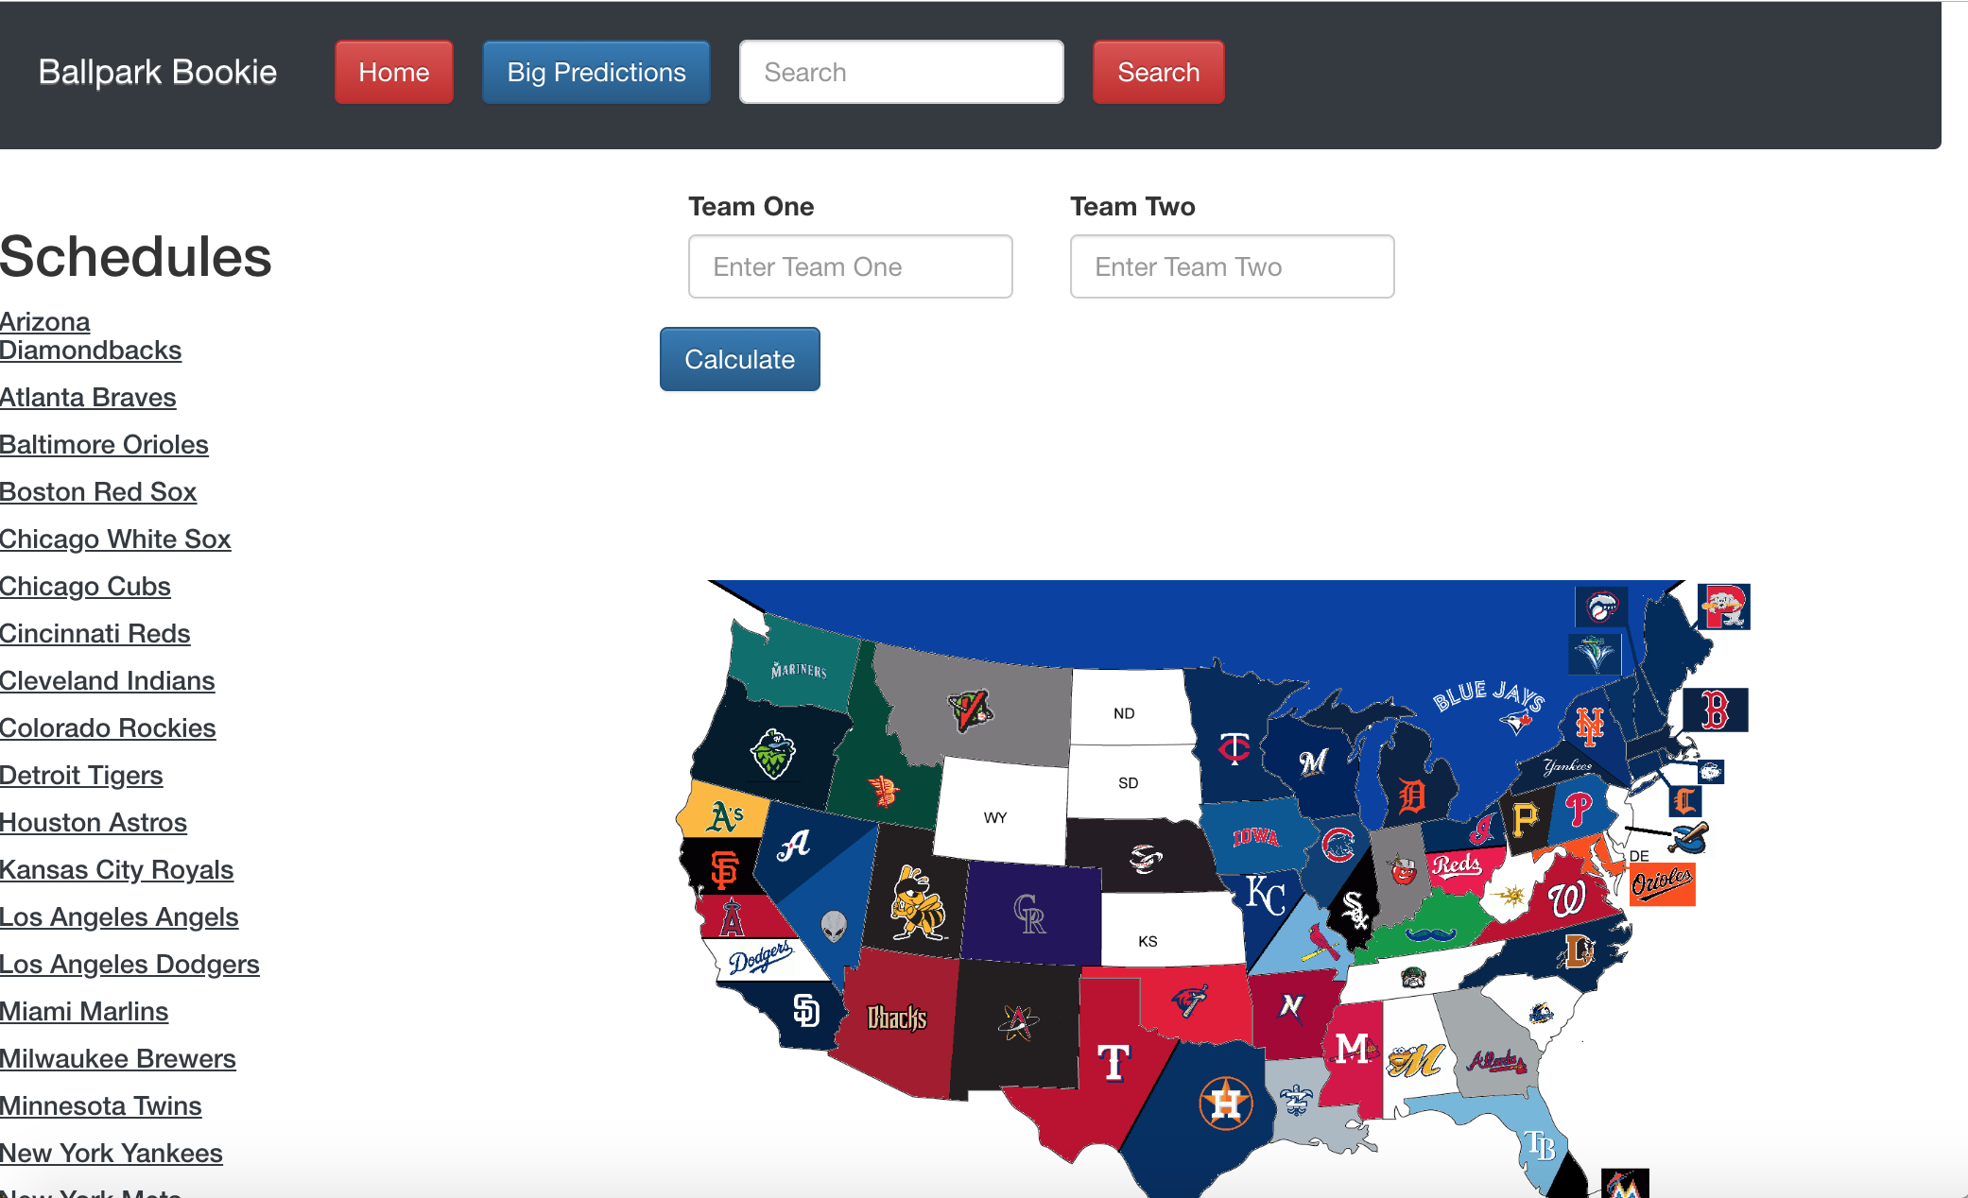
Screenshot

Slide 5






Resources

